Slide 1

Analyzing the safety of cycling across Bogotá
A study on minimizing exposure to atmospheric pollutants
Abdullah Alyamani, Gabriel Perez 7/12/2023

Slide 2
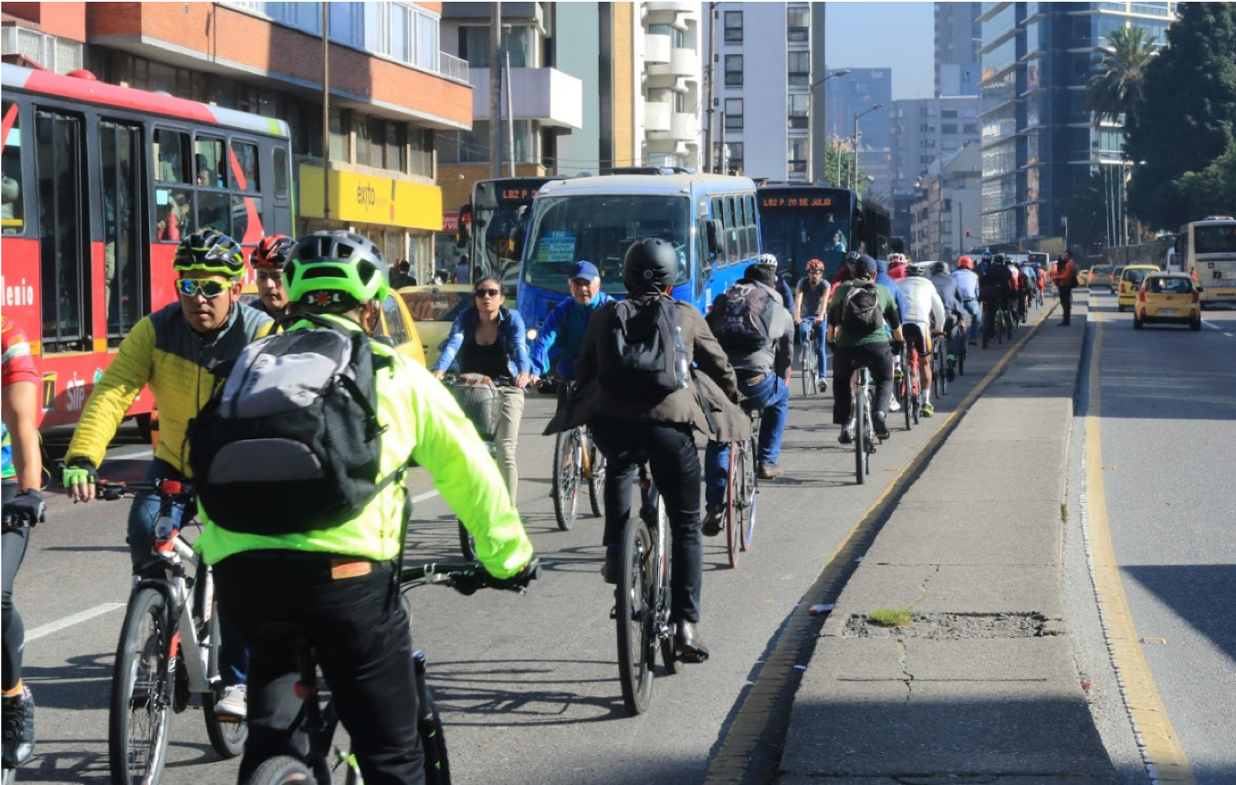
Motivation
Motivation
The cycling scene is very popular in Bogota
Bogota is known for its atmospheric pollution
Cyclers are one of the groups affected by air pollution
Bogota has a large bike-dedicated infrastructure
The mobility dynamic of the city forces people to use the bicycle
The city has more than 450 km of bike-paths¹
There are near 600 thousand trips made by bicycles daily, 6% of the total daily trips¹
1M people out of 10M uses bicycles daily as a mean of transport
Recently, Bogota experienced high population growth accompanied with an increase in number of vehicles leading to high dangerous emissions
Also, the growing industrial scene did make the problem of air pollution worse
The existence of unregulated small factories is a big contribution to the pollution in the south
Cycling is a physical activity that requires the individual to breathe hard, forcing the inhalation of pollutants
Cycling is also super encouraged as a form of sustainable transportation mode, and to also decrease the number of cars in the road
Bike-paths in Bogota are located alongside busy roads. Latest administrations have turned cars dedicated roads into cycling ones
Sources:
1. Ríos et al., 2015
Notes:
Gabby

Slide 3

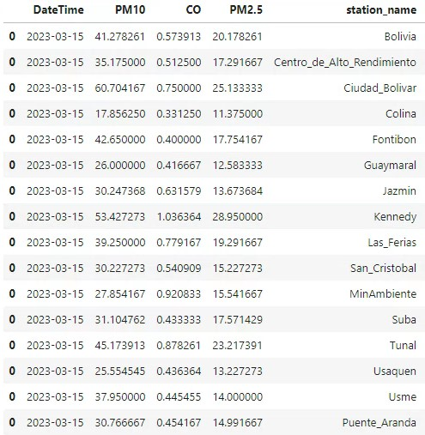
To understand more about the problem, we resorted to prelimenary research
Air pollution is mostly exceeding WHO guidelines
Bogota is listed among the most polluted cities in Latin America¹
Quick overview of the monitoring station shows many exceedances in 2023. Pollutants included: PM2.5, PM10²
Inhaling PM2.5 can cause: premature mortality, heart and lung problems, asthma attacks³
WHO Air quality standards:
PM2.5: daily average of 15μg/m3; yearly average 5μg/m3
PM10: daily average of 45μg/m3; yearly average 15μg/m3
10 out of 16 stations recorded exceedance in PM2.5
3 out of 16 recorded exceedance in PM10
Sources:
1. WHO, 2016; 2. Monitoring station; 3. California Air Resources Board
Notes:
Abi
“For PM2.5, short-term exposures (up to 24-hours duration) have been associated with premature mortality, increased hospital admissions for heart or lung causes, acute and chronic bronchitis, asthma attacks, emergency room visits, respiratory symptoms, and restricted activity days.”

Slide 4
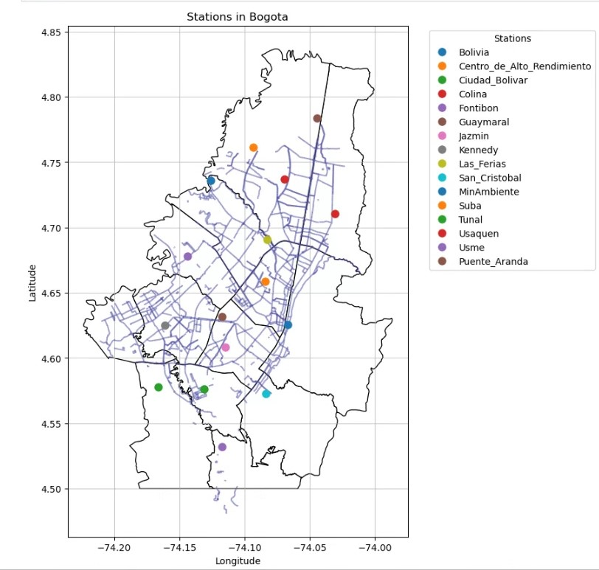
We constrained the study on the urban part of Bogota
The extent of the study area
(Data availability):
Bicycle paths data are only available for the northern part
Our stations contained much more pollutants, but we had to omit them because the information is not complete
The industrial area is located here
Most of the population is in this area
Notes:
Abi
There are some municipalities without station
The south is heavily empty
No bicycle roads in the south

Slide 5
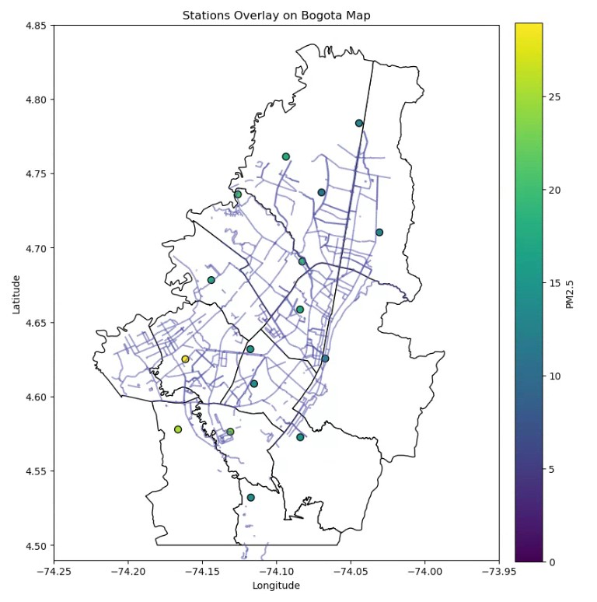
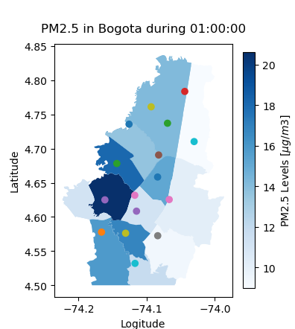
Only viewing station data will not help to show the affected road bikes
View of 1 day station readings for PM2.5 (2023-03-15)
Simply showing choropleth plot with the station data point is unreal
Is it safe?
No stations
No good coverage
Notes:
Abi
We can clearly see that in some areas there are exceedances
And we can see bike-paths affected
Does that mean it is safe to cycle along that path?
In municipality without data point, we combined another station, which is still not accurate

Slide 6
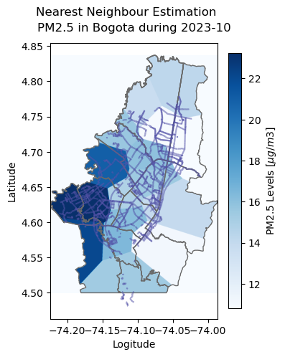
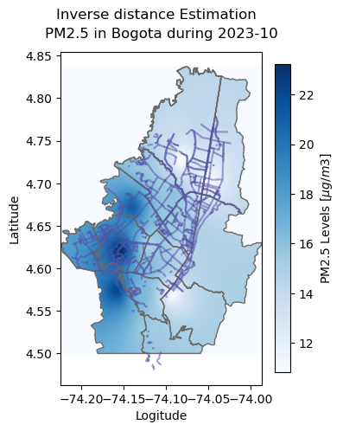
In order to view the spatial extent of pollutants, we used different estimation methods
Notes:
Abi
We can clearly see the cutoff, and the hazardous bicycle roads, but this is a 24 hours average of 1 day in the whole year
Complexity and Computation: NearestNDInterpolator is simpler and faster computationally as it considers only the nearest point. IDW is more computationally intensive as it involves calculating distances and weights for multiple points.
Resulting Estimates: IDW can provide a smoother estimate across space, especially when there are multiple nearby points influencing the estimation. NearestNDInterpolator can lead to a more abrupt change in the estimated value, especially if the nearest points are not uniformly distributed.
Assumptions About Data: IDW assumes a smooth spatial variation, while NearestNDInterpolator does not make any assumption about the smoothness of the variable being interpolated.

Slide 7
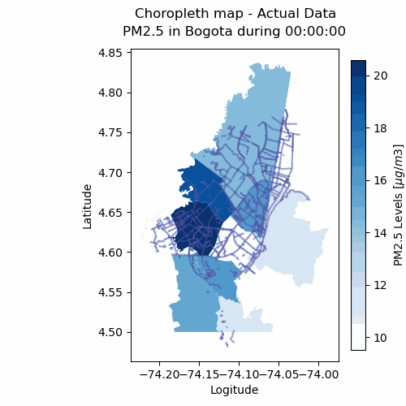
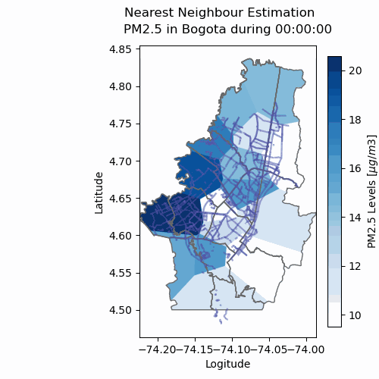
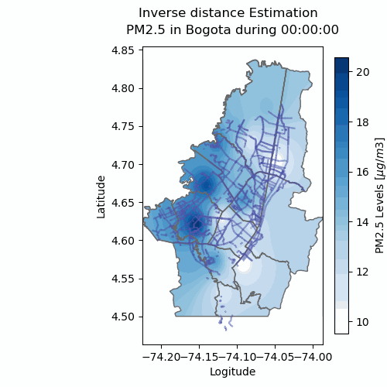
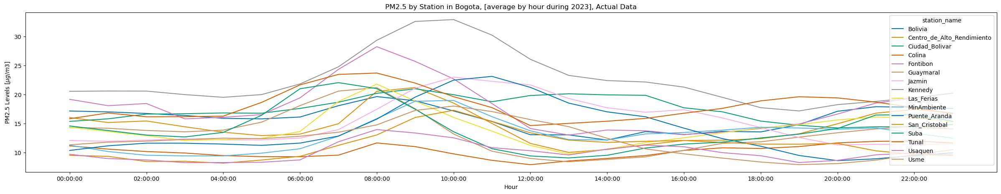
The spatial distribution of the average of pollutant by hour during a year, 2023
Notes:
Gabby
This is average by hour during a whole year..
We can see dynamics of the city, and we simply can see where the peak of the day is, and that is mainly because of people leaving for work..

Slide 8
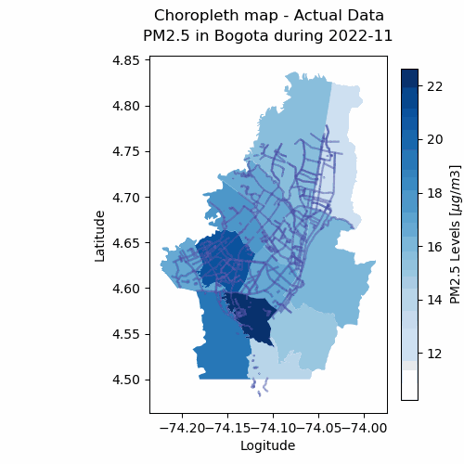
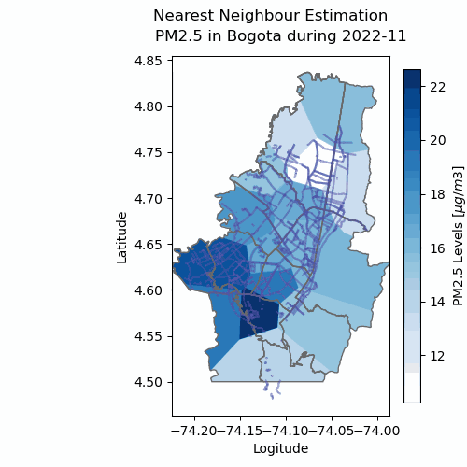
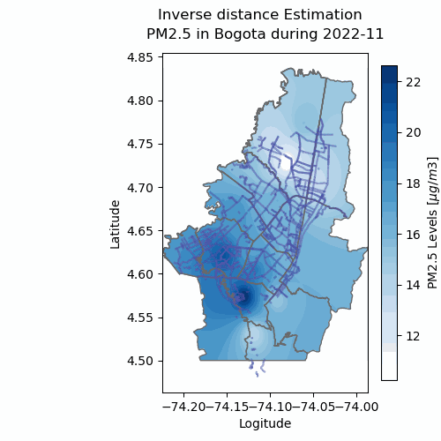
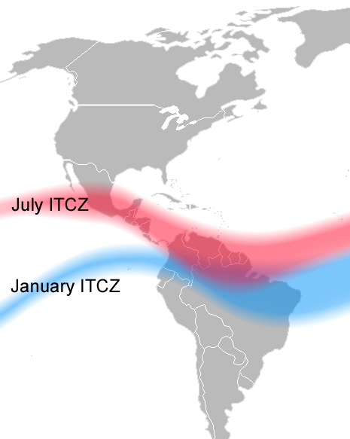
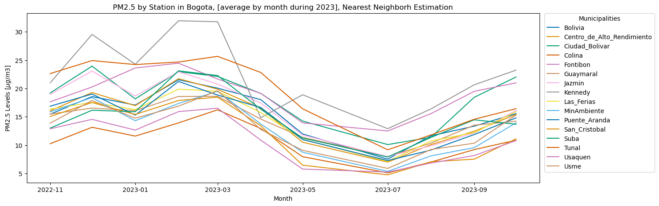
The spatial distribution of the pollutant shown in monthly averages over a year
Notes:
Abi
Here we have the distribution averaged by month for a whole year..
With this we can see the seasonal behaviour of the pollutants, that is mainly affected by the dry and rainy seasons in Colombia..
During the dry season, there are wild fires in the east region of the country. Then easterly winds come carrying the particulate matter into the city..
- Another condition that might add to the severity is the mixing layer height..
It can be smaller during that season, so it may be associated with higher concentration of pollutants

Slide 9
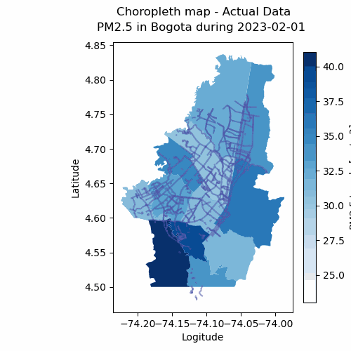
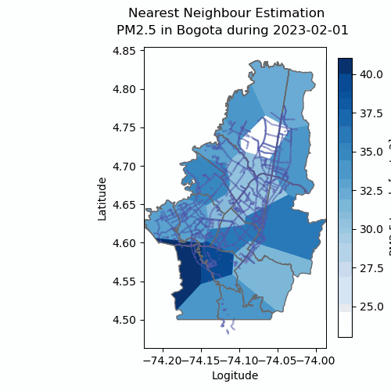
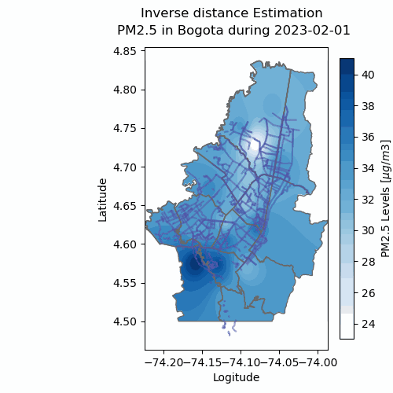
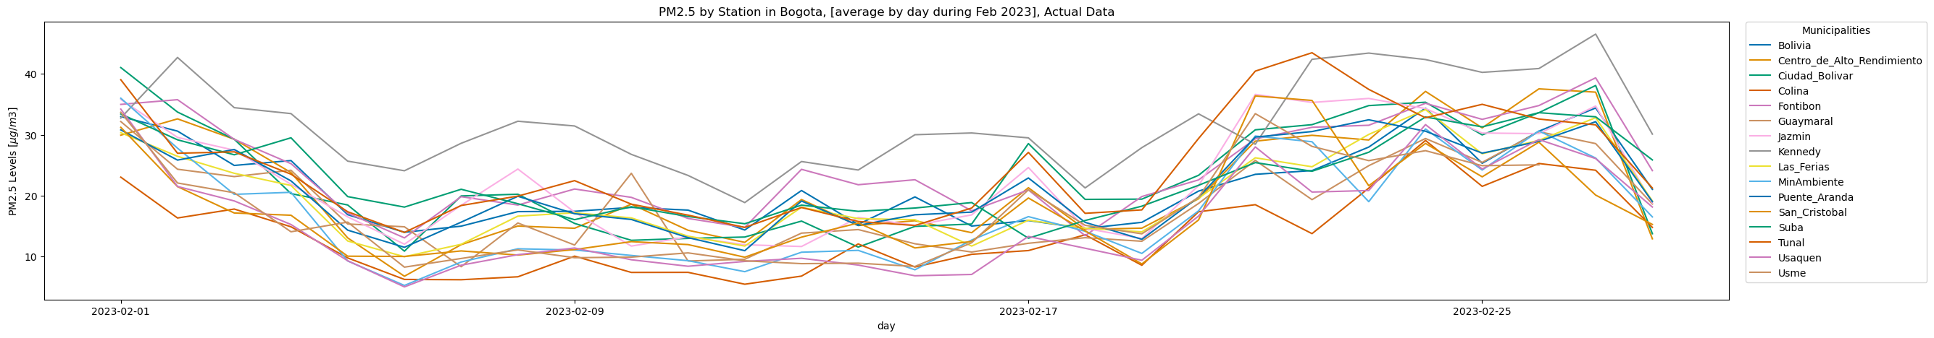
The spatial distribution of the pollutant shown in daily averages over a month
Notes:
Abi
We can clearly see the cutoff, and the hazardous bicycle roads, but this is a 24 hours average of 1 day in the whole year

Slide 10
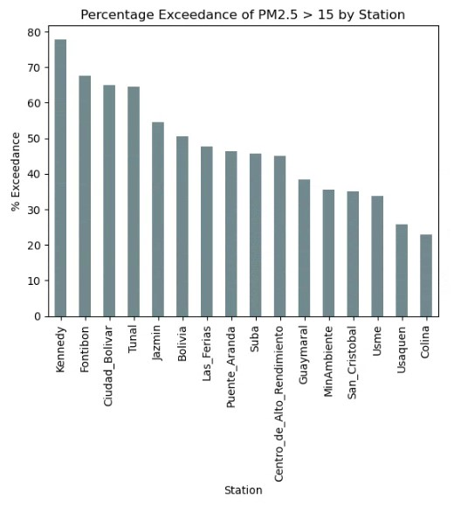
Most of the contamination is concentrated in the south-west region of the study area
Notes:
Gabby
Reasons for this concentration:
1. Industrial zone
2. Down wind

Slide 11
Discussion & limitation
It was somewhat difficult to quantify the extent of the hazard, it is best shown in a map animation to the affected areas
The coverage of stations is not ideal
There are some missing data; and that is affecting our inverse distance estimations by making it underestimating the values in some areas
Limitation on kriging for there are not enough points to analyze variability
The usage of inverse distance is justifiable in terms of air pollution
This analysis is done by considering environmental concentration of the pollutant. However, to analyze the exposure of cyclers to the pollutant, exposure data must be collected
Notes:
Gabby/Abi
Kriging is not really useful in our study because we don’t need to decluster
Inverse distance method; it is useful because it makes sense since dissipation of pollutants with the wind is a function of distance traveled

Slide 12
What we can conclude from this study:
Air quality in Bogota is bad, according to WHO criteria
On a daily basis, it is not safe for bikers to go around most of the cycling-paths in Bogota especially in the south-west region
There are three different contributions that add to the severity of the air pollution; local, regional, meteorological
There is a peak of pollutants in morning time [8am – 12pm]
There is a peak of pollutants in the beginning of the year from December to March

Slide 13
To further develop this study, we can do time analysis, look at different pollutants, and combine the findings in an index
We could further the analysis to include other pollutants
Analyze and quantify the extent of the different contributions
Develop a hazard index for bicycles with different pollutants
Through combining the hazard extent of the most dangerous pollutants and give it a weight supported by other research and combining the data to show hazard index on a map
Attempt to quantify the hazard extent
Notes:
This study can go to different directions for future developments:
Perhaps the diurnal peak will exist during rush hour
Maybe there is inversion during the night so the pollutants don’t get diluted
Maybe wind patterns and topography causes the pollutants to be trapped

Slide 14
Works cited
World Health Organization (WHO) Air Quality Guidelines (Aqgs) And ..., www.eea.europa.eu/publications/status- of-air-quality-in-Europe-2022/europes-air-quality-status-2022/world-health-organization-who-air. Accessed 5 Dec. 2023.
Franco, Juan F., et al. “Air Pollution alongside Bike-Paths in Bogotá-Colombia.” Frontiers, Frontiers, 9 Nov. 2016, www.frontiersin.org/articles/10.3389/fenvs.2016.00077/full.
Ríos Flores, et al. “Ciclo-Inclusión En América Latina y El Caribe: Guía Para Impulsar El Uso de La Bicicleta.” IDB, Inter-American Development Bank, 19 Feb. 2015, publications.iadb.org/es/ciclo-inclusion-en-america -latina-y-el-caribe-guia-para-impulsar-el-uso-de-la-bicicleta.
“California Air Resources Board.” Inhalable Particulate Matter and Health (PM2.5 and PM10) | California Air Resources Board, ww2.arb.ca.gov/resources/inhalable-particulate-matter-and- health#:~:text=For%20PM2.5%2C%20short%2D,symptoms%2C%20and%20restricted%20activity%20da ys. Accessed 5 Dec. 2023.

Slide 15
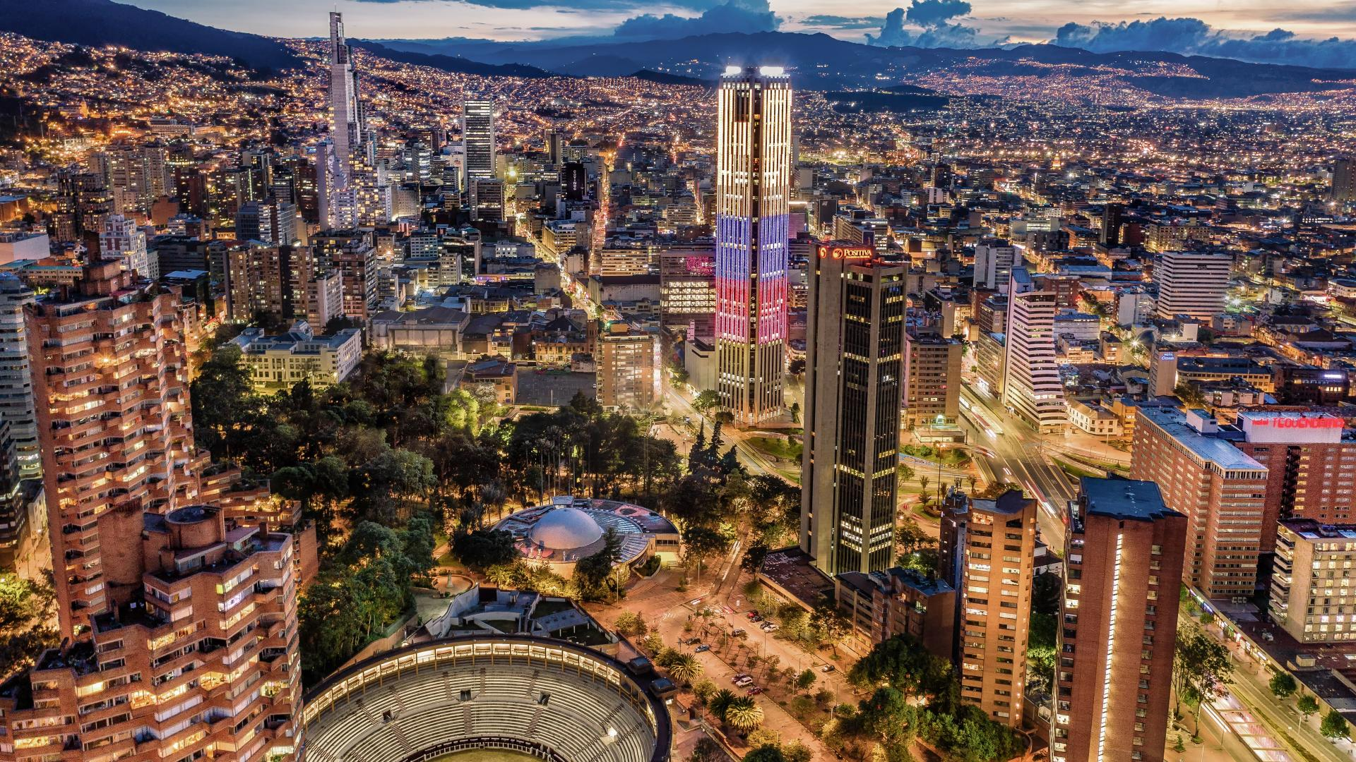
Any Questions?
Abdullah Alyamani, Gabriel Perez 7/12/2023

Slide 16
Thank you
Abdullah Alyamani, Gabriel Perez 7/12/2023

